Slide 1
Psychological Safety:
The Driving Force Behind Career and Business Impact
Michael P. McMullan, MOD
Senior Partner BlueEQ™
Notes:
Hi everyone, I’m Mike McMullan, and I’m glad to be with you today. I appreciate the opportunity to spend some time with you and talk about EI. And hopefully, we’ll be able to approach this in a way that is a new to you. I hope you will gain some new insights from our discussion today.
Let’s begin by looking at the Agenda. slide

Slide 2
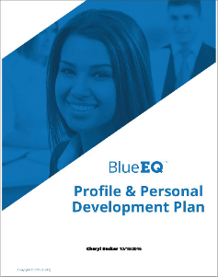
BlueEQ Assessment
Notes:
Validity, reliability
Do me a favor and stick around until the end the program and we’ll tell you how you can take the assessment.

Slide 3
Workshop Agenda
1
Business Essentials
2
The Training Solution
3
The #1 Success Factor
4
Psychological Safety & Core Logic
5
The BlueEQ™ Model
6
Creating Sustainable Behavioral Change
7
The Market-Leading BlueEQ™ Solution
Notes:
Review agenda.

Slide 4
Business essentials

Slide 5

Management Evolution and EI
Rabble Theory
Frederick Winslow Taylor
The Hawthorne Effect (Elton Mayo)
Maslow’s Hierarchy of Needs
Douglas McGregor (The Human Side of Enterprise)
Frederick Herzberg (Motivation-Hygiene Theory)
Peter Senge (Building Learning Organizations)
Emotional Intelligence

Slide 6
People, Process & Planning
Process
Planning
People

Slide 7
Funnel Diagram
Work Volume
External Environment
Internal Environment
Volume
&
Velocity
Capability
&
Capacity
$

Slide 8
The training solution

Slide 9
Training and Expected Results
Efficiency
Effectiveness
The results of effort (biggest bang for your buck)
Productivity
The amount of work accomplished
Quality
The time required to complete tasks
Cost
The degree of excellence
The expense per unit produced

Slide 10
Knowing vs. Doing
Knowing
Doing

Slide 11
Knowing vs. Doing
Don’t Know
Do
Know
Do
Want to
Know how to
Not allowed to
Do
Don’t Know
Don’t Do
Know
Don’t Do
Know

Slide 12
The #1 Success Factor

Slide 13


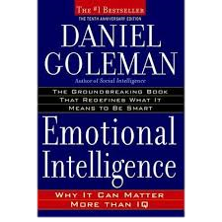
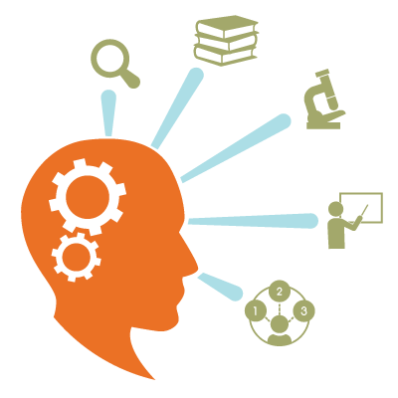
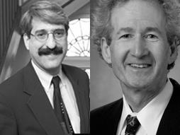
This is No Fad!
1
2
3
4
1990
Peter Salovey &
John Mayer
“Emotional
Intelligence”
1995
Daniel Goleman
Emotional
Intelligence
1995-2017
Explosion of
Research
&
Training
2016
World Economic
Forum
Top 10 Skill for
2020
Notes:
We all know that EI is nothing new, but let’s look at where EI has come over the past…nearly 30 years. In 1990 Peter Salovey (Yale U) and John Mayer (U. of New Hampshire) got together and published an academic article and called it “Emotional Intelligence.” And this put EI on the map. It introduce EI into the academic world, and from there things really began to take off. Just 5 years later, Daniel Goleman, who was a science writer for the New York Times, wrote his book IE, which was a summary and a synthesis of everything that had been learned since the Salovey/Mayer article. Goleman’s book became a bestseller and really captured the attention and imagination of people all over the world. Since 1995, there has been an explosion of research and training in the area of EI. In 2016, at the World Economic Forum, EI was identified as one of the top 10 skills needed by a globalizing and modernizing workforce by the year 2020. The punch line is that EI is not a fad. It’s not going away. The research has exploded along with training. The question is Why is EI important. I think that people intuitively understand that EI is really important. Most people know that we need to understand our emotions and the emotions of others for us to have influence and be effective. But the question still arises…so what? What happens if EI is improved? What’s the difference? There is much more evidence to the value of EI that goes beyond intuitive understanding. In the past few years empirical research that has provided an important discovery. Slide

Slide 14
The Value of Emotional Intelligence
Out of 181 competence models identified,
67% of the abilities deemed essential for
EFFECTIVE JOB PERFORMANCE are Emotional Competencies!!
Compared to IQ & Expertise
EMOTIONAL COMPETENCE MATTERS TWICE AS MUCH ACROSS ALL JOBS AND ALL JOB CATEGORIES!
Goleman: Working with Emotional Intelligence, 1998

Slide 15

Why Emotional Intelligence?
Emotional intelligence is the conduit of influence and collaboration
Notes:
Here’s another way of looking at it: (read statement: EI is the conduit…). Why is that? Because innovation and execution, which are the two primary processes we have in any organization, those processes are primarily social process. EI allows us to work effectively with each other. slide

Slide 16
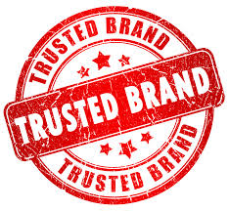
Brand Keeping & Brand Breaking
When an employee breaks an organization’s brand promise, how often is it related to EQ?
90%
Notes:
One last finding that is absolutely fascinating. EI is connected to an employee’s ability to keep the brand promise of the organization he/she represents. Think about it. Every time you interact with an employee from another organization, that brand promise is put to the test. And you’re gonna walk away from that interaction thinking they kept, broke, or even exceeded that brand promise. Here is the all important research finding. When and employee brakes and organizations brand promise, how often is it related to EQ? 90%. So it’s absolutely impossible to be a consistent brand ambassador without a threshold level of EI. That’s what it takes for organizations to make and keep brand promises on a consistent basis.
Daniel Kahneman: psychology of judgement and decision-making…people not rational
Slide

Slide 17
Psychological safety & Core Logic

Slide 18
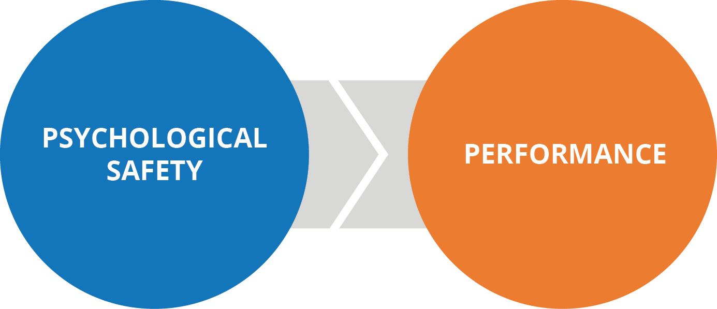
The Great Discovery
Notes:
In fact, this may be one the top discoveries about human performance in the last century. The discovery is a very simple relationship. Psychological Safety creates, increases, and improves performance. I don’t know how familiar you are with the concept of PS, but it is at the heart of why EI has exploded in research, training, and measurement. So let’s talk a little bit about this cause/effect relationship that makes IE so important. Slide

Slide 19

Psychological Safety
A shared belief that it’s safe to discuss ideas, experiment, take risks, give feedback, and learn from mistakes.
Fact: Every person in every organization creates a psychological zone. What kind of zone do you create?
1. Very Unsafe | 2. Unsafe | 3. Neutral | 4. Safe | 5. Very Safe
Notes:
Here’s the definition of psychological safety: “A shared belief that it’s safe to discuss ideas, experiment, take risks, give feedback, and learn from mistakes.” As a matter of fact, the research shows that every person creates a Psychological zone. I want you to think about that for minute. Look at the continuum at the bottom of the slide. You’ll see that it ranges from very unsafe (red) to very safe (blue). The point is, everyone creates a psychological zone. It’s the vibe, the feeling you give off…the atmosphere or climate you create around you. That’s what PS is. You can range from a Red Zone to a Blue Zone. The point is, that the level of PS has a direct impact on the behavior of people. Let me give you an example: Slide

Slide 20

The Red Zone
Self- Preservation
Risk- Management
Pain- Avoidance
Notes:
Here’s an example of a team that is a little downtrodden. They are working in a Red Zone. If you’re in a Red Zone, you don’t feel empowered, that you’ve been given permission to participate in a way that you might like…in terms of asking questions, sharing ideas, challenging the status quo. If you’re in a red zone, you retreat to self-preservation, risk-management, and pain-avoidance. On the other hand, if you’re in blue zone…slide
20

Slide 21
The Costs of Low Psychological Safety
48% intentionally decreased their work effort.
47% intentionally decreased the time spent at work.
38% intentionally decreased the quality of their work.
80% lost work time worrying about the incident.
63% lost work time avoiding the offender.
66% said that their performance declined.
78% said that their commitment to the organization declined.
12% said that they left their job because of the uncivil treatment.
25% admitted to taking their frustration out on customers.
(Source: 12- Year Harvard Study, 2013).
Notes:
…here’s what we find from more research based on a 12-year Harvard Study. These are some of the findings from low PS. Just take a look at the first bullet. 48% of employees intentionally decrease their work effort if they are working in a red zone. (read two more…2nd and 3rd) I won’t take time to go through all of these, but the ramifications of low PS are enormous. So people want to know, how do we improve or at least change the PS in our organization? Slide
Source: Christine Porath and Christine Pearson, “The Price of Incivility.” Harvard Business Review, Jan-Feb 2013.

Slide 22

The Blue Zone
Career-Best Contribution
Discretionary Effort
Peak Engagement
Notes:
…that has a direct impact on your behavior as well. The patters we observes are that people give their career-best contribution, they release their discretionary effort instead of freezing it or holding back, and they have peak engagement experiences. The underlying level of PS makes all the difference. If we work backwards…slide
22

Slide 23

EQ, PS, and Business Impact
Business Impact
Safety Performance
Business Impact
Employee Selection
Business Impact
Leadership Effectiveness
Business Impact
Market Share
Business Impact
Customer
Service
Business Impact
Sales Productivity
Business Impact
Profit Growth
Business Impact
Employee Retention
Business Impact
Productivity
Business Impact
Brand Building

Slide 24
EQ, PS, and Business Impact
Safety performance
Researcher David McClelland showed that after supervisors in a manufacturing plan received training in emotional competencies such as h ow to listen better, lost-time accidents decreased by 50%
Employee selection
The United States Air Force reduced first-year turnover due to mismatches and cut their poor-hire financial losses by approximately 92% by screening job candidates for emotional intelligence skills
Leadership effectiveness
According to a study of 236 executives conducted by the Center for Creative Leadership, at least 55% of overall successful leadership is based on emotional intelligence factors.
Market share
Sheraton Hotels increased market share by 24% as a result of an EQ initiative that involved short training sessions focused on enhancing EQ skills.
Business Impact
The Carnegie Institute of Technology carried out research that showed 85% of customer service effectiveness was due to EQ skills, such as empathy, communication, and influence. They found that only 15% was due to technical ability.
Sales productivity
MetLife salespeople with high EQ outsold their peers within by 37%. Each member of the L’Oréal sales force selected on the basis of EQ competencies sold $91,370 more than others did who were not.
Profit growth
In a study of Whitebread restaurants in the UK, researchers found that restaurants managed by managers with high emotional intelligence showed an annual profit growth of 22%versus and annual average growth of 15% for the same period.
Employee retention
In a study by Fortune magazine, 70% of employees who leave their organizations report relationship issues with either their boss or co-workers as the primary reason for leaving.
productivity
Pepsi found that executives with high EQs generated 10% more productivity, had 87% less turnover, brought $3.75M more value to the company, and increased ROI by 1000%.
Business Impact
Shareholders of Nike, Gatorade and other Tiger Woods sponsors lost a collective $5 to %12 billion in the wake of his extramarital affairs, according to a new study by researchers at the UC Davis.

Slide 25





Psychological Safety Drives Results
87% less turnover
24% market share growth
85% of financial success due to EQ
$2.5M more sales
Notes:
However, EQ and Psychological Safety are really a means to an end because ultimately they combine to create tangible business results. Here ae some examples from our research:
Pepsi had 87% less turnover
Loreal’s research shown sales people with High EQ sold $2.5M more than others
Sheraton grew their market share by 24%
And Carnegie Institute highlighted 85% of a person’s financial success is due to EQ skills.
There are more and more studies being done that show the impact of EQ. People used to speculate about the relationship between EQ and business results. They no longer speculate. We know EQ has impact. That’s why it’s become a focus and priority in so many organizations today.
Suggestion – ask the client “which important business results would you like to target?” This is a way to build the right hand side of an impact map impact map and make the presentation more personal for them.
Source: http://www.huffingtonpost.com/anne-loehr/why-emotional-intelligence-affects-the-bottom-line-_b_7295444.html
Source: http://blogs.edweek.org/edweek/rulesforengagement/SEL-Revised.pdf

Slide 26
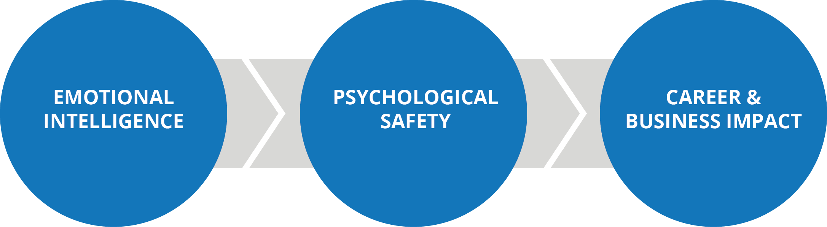
The Core Logic
Notes:
Here’s the way that it works. We know that PS leads to career and business impact. What we need is EI to make it work. EI is the single most important skill that drives and increases PS in an organization. This is what we call the core logic? We begin with EI, which increases PS and produces the results we are looking for in our career and business. EI and PS are important to us individually, personally in terms of our careers, and of course, organizationally. This core logic, this fundamental cause and effect relationship among these three variables has been verified over and over by a growing body of empirical research. That is why EI is no fad. It’s not going a way. Not a fashionable, transient idea. It’s here to stay. The only question is, what are we going to do about it?

Slide 27
The BlueEQ™ Model
Notes:
OK, let’s talk a little bit about the BlueEQ model. This is a model that might be new for some of you. It is based on a comprehensive review of the research literature. Here’s what it looks like. Slide

Slide 28
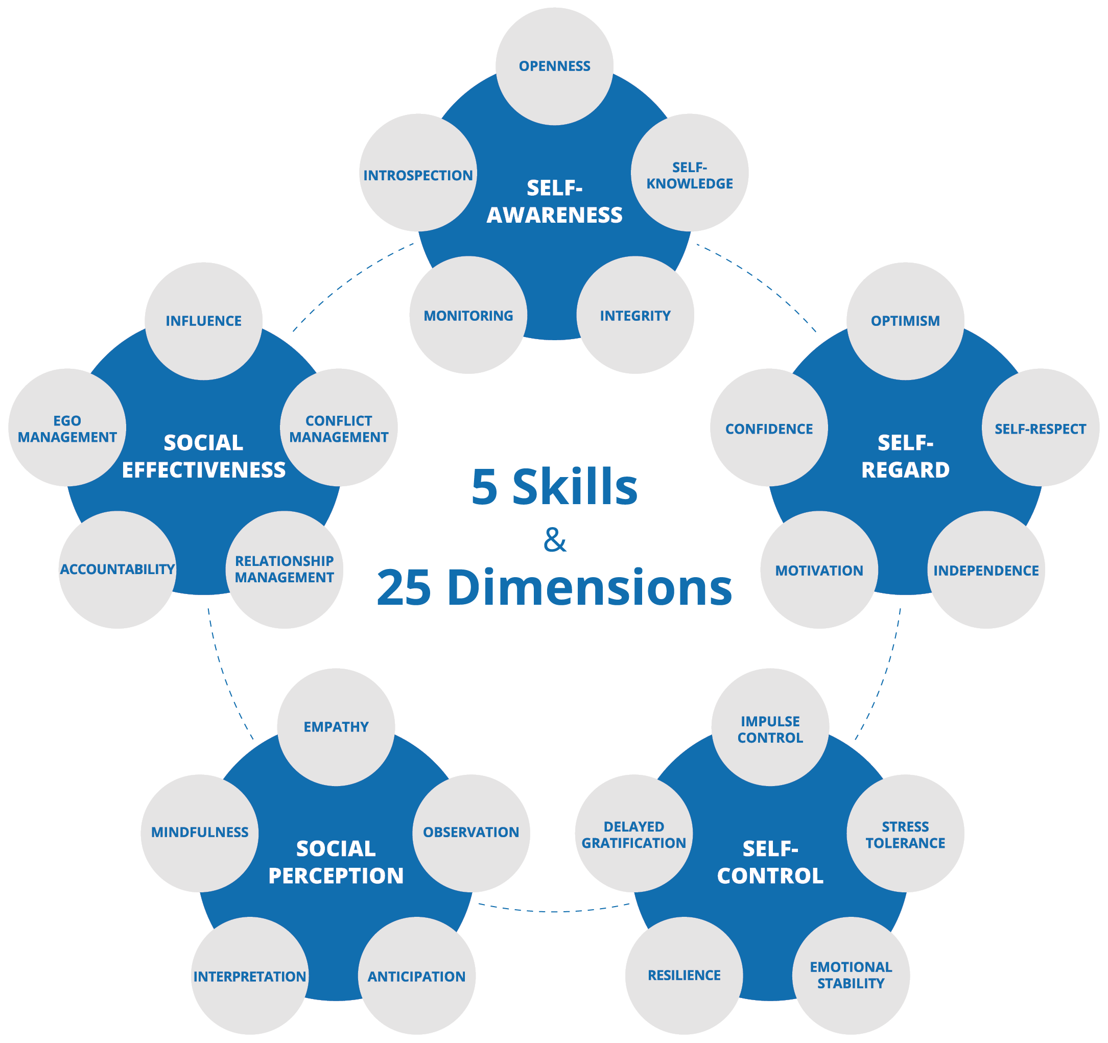
The Five Skills
Notes:
Here’s what it looks like. There are five primary skills. The first three are associated with, what we call, the inner or the internal realm of EI. Self-Awarness is the first one, then we have self-regard (which means the way that you think and believe about yourself). Self-control is the third – so those three deal with the inner world. And then we have two skills that relate to the external realm or the world outside you: social perception and social effectiveness. In the end the culminated skill is social effectiveness, this is what we are after, what we are trying to accomplish. That is what allows us to scale our influence and impact with others, this allows us to make our highest and best contribution. Each of these skill areas, as you can see from the model, has what we call dimensions that are directly associated with the skill. So, for example, Self-Control has 5 dimensions: we have impulse control, stress tolerance, emotional stability, and delayed gratification. That’s just one example out of the five. Each skill areas has 5 dimensions or sub skills. So in all, there are 5 skills and 25 dimensions. This is what many people consider to be the most comprehensive and accurate model for EI. EI is a multi-faceted variable, it’s what we call a cluster variable in research. It’s not easy to measure, so you have to operationalize different skills and dimensions. So, let me show you how we do this. Slide

Slide 29
Notes:
What you see on this slide is what we call a heat map. When you take the BlueEQ self-assessment, you are replying to 150 rapid response questions. There is a question set or scale for each of the 5 skill areas in the 25 dimensions. Your results come back to you looking something like this. Where each skill an dimensions is color-coded that runs from blue to red. As you can see from the key at the bottom, a blue result is a success factor. A red result indicates a risk factor. This is an innovation that client organizations around the world are delighted with because you have a very large data set that is represented on one piece of paper. All of your results are summarized right in front of you. Now, let me ask a question: So what does blue mean? What is the significance? As you can see, blue indicates a success factor, mastery, the level of proficiency we are trying to achieve. That is where the name BlueEQ comes from. That is our aspiration—to move our profile into the blue as much as possible. In addition to the heat map, when you take the assessment (slide)…
Say: The best way to interpret you result is to look at your color map—which of course summarizes all of your results—and then ask some very specific questions. Now we don’t know this person. We can see his results, but unless we know the person, we can’t interpret the results very well at all. So in order to do high quality interpretation, we need two things: First, we need to know the person. This is a self-assessment, so you have that covered. Second, you need to know the questions to ask yourself.
Say: There are eight specific questions you need to ask to do thorough and accurate interpretation. Let me share these with you.
Do: Next slide.

Slide 30
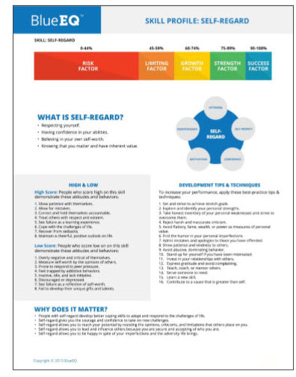
Notes:
…you also receive an individual assessment for every single skill in all 25 dimensions that gives you a definition of the dimension or the skill, a profile of what it looks like behaviorally if you have a high or low level of it, a set of tips and techniques that are very concrete and behavioral, and an explanation of why it matters…personally and professionally and what its impact is. So that give you an idea of what the BlueEQ model looks like and what the output of the assessment looks like as well.
Say: The best way to interpret you result is to look at your color map—which of course summarizes all of your results—and then ask some very specific questions. Now we don’t know this person. We can see his results, but unless we know the person, we can’t interpret the results very well at all. So in order to do high quality interpretation, we need two things: First, we need to know the person. This is a self-assessment, so you have that covered. Second, you need to know the questions to ask yourself.
Say: There are eight specific questions you need to ask to do thorough and accurate interpretation. Let me share these with you.
Do: Next slide.

Slide 31
Creating Sustainable Behavioral Change
Notes:
Let’s transition a little bit and talk about creating sustainable behavioral change, which is the goal when it comes to EI. It’s a learnable skill; therefore, when we seek to improve our EI, we want to see appreciable gains; we want to make progress, and we want to maintain the improvements we make. Slide

Slide 32

Fixed Trait vs. Learnable Skill?
“Temperament is constitutional and not changeable.”
—Erich Fromm
German Social Psychologist
Notes:
Now, here’s the good news. EI is considered by behavioral scientists to be a learnable skill, it’s not a fixed trait. Now that make all the difference because it means that people can change behaviors. They can improve their EI. Our core temperament …is consider a fixed trait—qualities and characteristics that are innate. Personality tests help us understand who we are, but emotional intelligence deals with who we can become. The reason we know this is because we have a mountain of data showing that people have made significant improvements in EI. That is the great news about EI. Slide
Most behavioral scientists agree that a person’s basic disposition and temperament remained relatively unchanged over time and is therefore considered a “fixed trait.” EQ on the other hand is something that can be learned, changed, and improved. In fact, it is universally acknowledged by most researchers in field of emotional intelligence that it can be learned. How do we know this? Several studies have been done and continue to be done that shows significant improvements over time in grade-school, middle school, high school, and college students. Even if we acknowledge and stipulate that older professionals may change more slowly, we have ample evidence that working professionals of all ages and stages can improve their emotional intelligence skills.
Source: Erich Fromm, Man for Himself: An Inquiry into the Psychology of Ethics, 1947, chapter three.

Slide 33
Regression to the Mean
New Level of Performance
Performance
Begin Change
Regression to the Mean
Current Level of Performance
Time
Notes:
Unfortunately, we have a dominate failure pattern that we need to be aware of. We call this Regression to the Mean – a term that comes from statistics. It basically means that when we begin making changes we reach a critical juncture where we either maintain our new level of performance or we go back or regress to our previous level. That regression to the mean is the dominant pattern. So, as our team of behavioral scientists have been working very hard to understand how to overcome this, we’ve come up with a methodology to set us up for success. Once we know what we want to work on or what we want to change, then we can employ a process that works. Slide

Slide 34
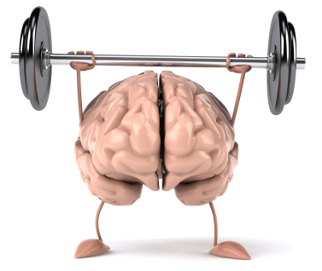
Building New Muscle Memory in 30-90 Days
Notes:
So what we’re after is to create muscle memory. Muscle memory is like riding a bike. Once you learn how, you never really forget. You don’t have to relearn the skill of riding a bike. And this is what we’re trying to accomplish with developing EI skills. And the research shows, you need between 30 and 90 days to do that. You need that much time to practice, establish a new pattern, and to maintain that new pattern. Slide
Ask: Who can tell us what muscle memory is?
Do: Solicit responses and discuss.
Say: Muscle memory means that through repetition you learn to do something and the memory of doing it stays with you until you perform the task or behavioral almost without thinking. It become normal and natural to you. Now we use the term primarily in learning motor skills as in athletics, but the same concept applies to emotional intelligence behaviors.
Ask: What’s the most important thing that we have to do to create new muscle memory? (Answer: practice or engage in repetition).
Say: Based on behavioral research, we have learned that a 90-day timeframe is ideal. Less than 90 days is often not enough time. More than 90 days and what happens? That’s right, people lose their motivation. So if you can build new muscle memory in a 90-day period, you have a really good chance that you will sustain the improvement and not “regress to the mean.”
Say: So the entire i4p process is based on this concept.
Do: Next slide.

Slide 35

Getting Traction
Research shows that an individual can focus on no more than three development goals at a time.
Notes:
The other key piece of insight from research, is that in order to gain traction—to get moving, an individual can handle no more than 3 goals at time, often 2 is enough (Franklin plan). So, in our methodology, we go through our results and help the individual figure out what his/her top development goals are. Decide on 2 or 3 and then build what we call (slide)…

Slide 36
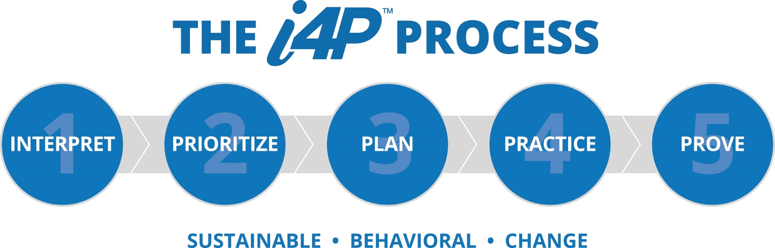
Notes:
…an i4P plan for those 2 or 3 development goals. The i4P process involves interpreting the results of your BlueEQ assessment results, prioritizing areas for development (2 or 3 based on career and business needs), making a 30 to 90 day plan for change, practicing specific things on a daily, weekly, monthly basis, and then proving (or measuring) that we’ve made progress over time. This is the process we’ve developed to help people avoid regressing to the mean. Patter that we see so often. People will take assessments, get excited about the results, but they really don’t know what to do next. The idea is to build a concrete behaviors plan that will help you make real progress. Slide

Slide 37
The market-leading BlueEQ™ Solution
Notes:
So, let’s talk a little bit about the BlueEQ solution, and then we’ll go into some Q & A. Slide

Slide 38




BlueEQ™ Integrated
Emotional Intelligence Solution
Before Workshop
Workshop
60-90 Day Development
Retest
Registration
Self-Assessment
Pre-work
Review Heatmap
Interpret Heatmap
Career Impact Goals
Business Impact Goals
Psychological Safety
i4P™ Planning
Skill-Building
Peer Coaching
Peer Coaching Sessions
Supervisor Accountability
Practice & Feedback
BlueEQ™ Academy
Self-Assessment Retest
i4P™ Update
Align Career Impact
Align Business Impact
Notes:
The BlueEQ solution is a market-leading, fully-integrated solution…and by fully integrated I mean it’s not just an assessment experience. It’s not just a training experience. It’s a full, development experience with at begins with assessment, with pre-work, with a review of your heat map, and then you go into the workshop. Which is a powerful, discovery-based experience. And highly interactive. And that is where you are able to interpret, identify your development goals and build your i4P plan. But you’re not done there. Because as we well know, training alone is limited unless an effort is made to apply what was learned. If you don’t continue the development process, the behavioral change you can expect is only about 5 to 10%. That’s the amount of learning transfer studies show. You have to move into the 30-90 day development process and practice new skills for sustainable change to take place. Here you have a peer coach, a supervisor/accountability session, getting feedback, and going to BlueEQ Academy, which is an on-line, on-demand learning center where you can access world-class, carefully curated development resources: videos, podcasts, blogs, and articles. The idea is that you consume 2 or3 three resources each week. It’s incorporated into your natural work streams. It’s a micro-learning approach that maintains momentum. You’ve got to maintain momentum for…really 60-90 days to develop the muscle memory that we talked about. And finally, stage four is to retest. Take the BlueEQ assessment again, and begin a second development cycle. Update your i4P, what are you going to work on now. Make sure you are aligning your needs with the career impact you most want. And then second, what does the organization need. If you can put those two together, there is a high probability that you will get traction and make the gains or changes that will really make a difference. So, that’s what we mean by integrated solution. And that is why BlueEQ is the market leader in EI. Slide

Slide 39
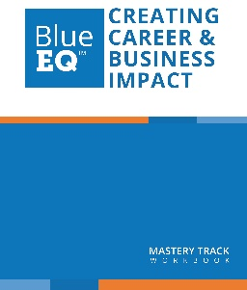
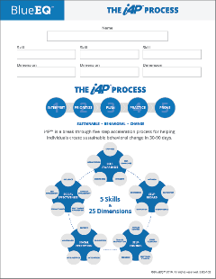
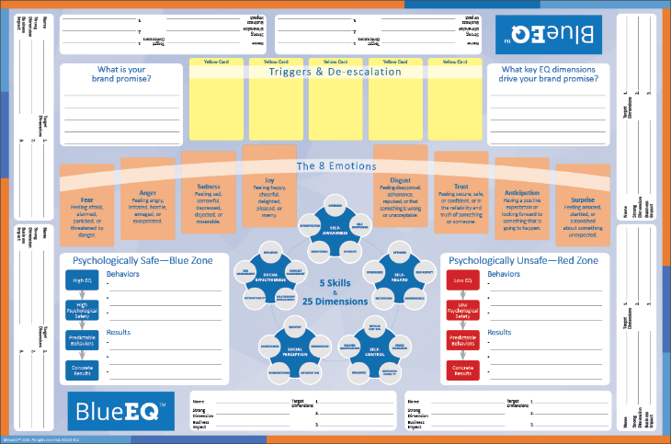
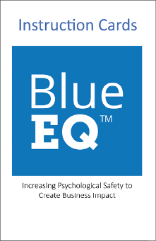
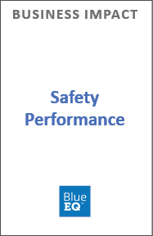
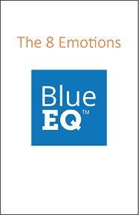
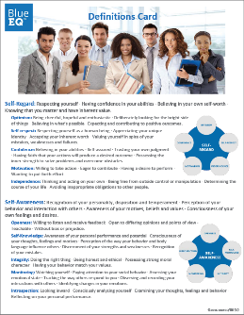
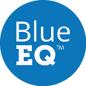
Overview
Notes:
Here’s a quick look at the materials for the workshop. You can see in the middle that we use a discovery-based learning map. This creates an intensely interactive, discovery-based process. We add to that video, all kinds of interactive experiences, and it really is an unbelievable learning opportunity. But the most important things is you come away with a deliverable…a complete i4P plan…and you move into stage 3 for the next 60 to 90 days. Slide (for meaningful and sustainable change)

Slide 40

The Iron Law of Sustainable Behavioral Change
Sustainable behavioral change is based on a transfer of ownership to the individual.
Notes:
So let me conclude with what we call the iron law of sustainable behavioral change. Here is what we’ve learned based on our accumulated client experience, based on comprehensive review of the practitioner and empirical research. Sustainable behavioral change (and I just want you to think about this individually)…sustainable behavioral change is based on a transfer of ownership to the individual. For example, today is the 2nd of March, las week, if you when to the gym it was hard to find a spin bike, if you go back in two weeks, what you you see? Lost of empty bikes. This gets to the point. Unless there is a transfer of ownership to the individual, all bets are off. This is true organizationally. You may be blessed with money, support, and training, a great boss, great peers…all of that. Those things are what we consider, in our business, scaffolding – or secondary support. And so in order to really move the needle and make the gains you really want and need, you have to transfer ownership to the individual. So the entire design of BlueEQ has been done with this in mind. Because, otherwise it is a transitory experience, and we experience that Regression to the Mean…and that’s the enemy. That’s what we’re trying to overcome. We know that the impact and the potential impact of EI is massive because it does create PS, and that does lead to Career and /business impact. So the idea, the goal, the intent is to do everything in our power to equip and empower the individual to take that ownership and make the gains. Slide. (So with that, we’d like all of you an opportunity to take the full version of the BlueEQ self-assessment (pay for it 140.00 reduced to 99 for these listeners …Veronica
The most important factor is personal commitment, or what we call a transfer of ownership to the individual. You have to own it. If you don’t own it, all the other support and resources won’t make it happen. Positive behavioral change literally depends on the personal ownership. I want to emphasize that because the process that we are going to go through in the next module to help us increase our emotional intelligence is based on this basic principle—”The individual owns his or her professional development.”
Throughout the course of your professional life, there will most likely be times when the organization will support you. There will probably also be times when you get much support. Your ability to move forward, progress, and develop can’t be dependent on the organization giving you support. That makes no sense. You have to own it from beginning to end.
Who can tell me Gandhi’s most famous statement about change? (Be the change you wish to see in the world.)
You may have heard that statement many times. It may sound cliché at this point. But it’s still true.
Can you think of a hard behavioral change that you have made and been able to sustain? How did you do it?
(Take responses.)

Slide 41
BlueEQ Assessment
Email:
info@blueeq.com
Notes:
Contact us, and we’ll send you a code to take the BlueEQ assessment.

